Slide 1
Dental Cavity Detection System Using CNN​
Navya Verma (20BAI1178)
Vaishnavi (20BAI1151)

Slide 2
Abstract
Dental carries is a major public health problem. The Global Burden of Disease Study 2019 estimated that oral diseases affect close to 3.5 billion people worldwide, with carries of permanent teeth being the most common condition.
The real disease burden is the number of unmet needs or the untreated decay.
Among children and adolescents, dental carries is 4 to 5 times more common than asthma.
Large segments of the population experience various barriers to care.
Data from the National Health and Nutrition Examination Survey 2011-2012 show that among children aged 2 to 8 years 37% had dental carries in their primary teeth. Among adolescents aged 12-19, the prevalence in permanent teeth was about 58%. About 90% of the adults aged >=20 had dental carries.

Slide 3
Introduction
The aim was to develop a strong and accurate system for predicting whether cavities exist in an image of a tooth that has been presented to the system.
Using the Kaggle dataset for teeth cavities, I trained the model to classify it the image of the teeth has any detectable dental carries or not.

Slide 4
Future Scope
In the future, this project’s model can be integrated with a simple toothbrush with a small camera in order to remotely capture images of people’s teeth and then process the image in the model to further classify the presence of any sort of dental cavities.
The model is aimed to solving the problem for people who do not have the means to go for dental appointments or for those who have a busy lifestyle.

Slide 5
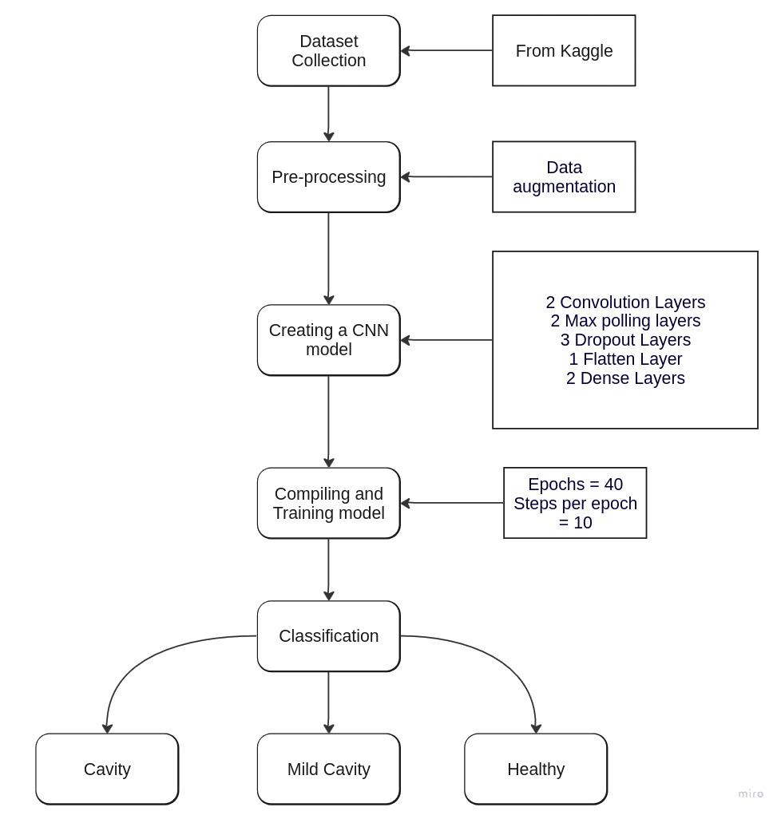

Slide 6
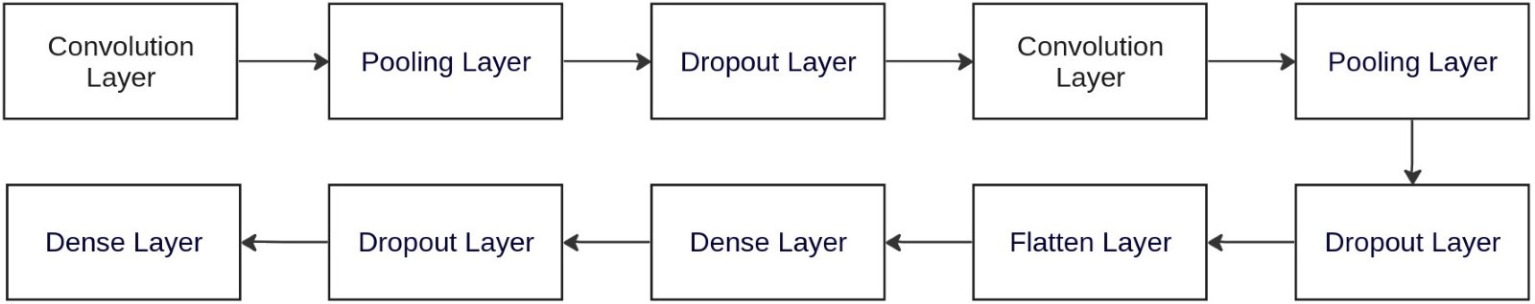

Slide 7
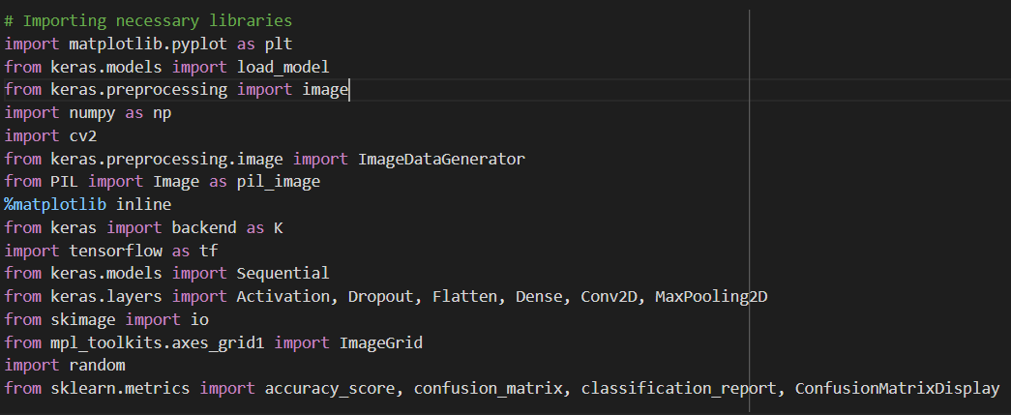

Slide 8
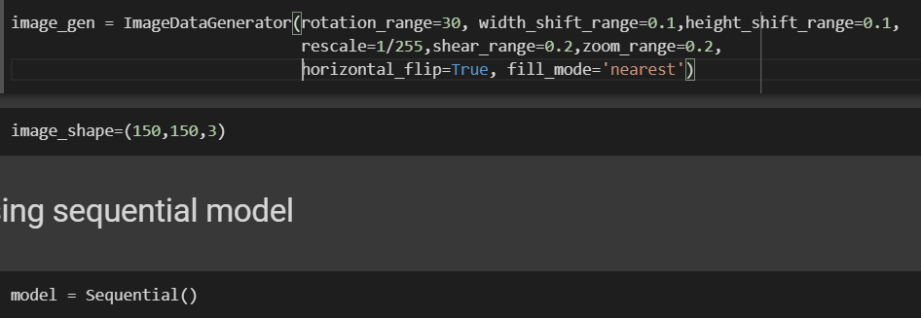

Slide 9


Slide 10
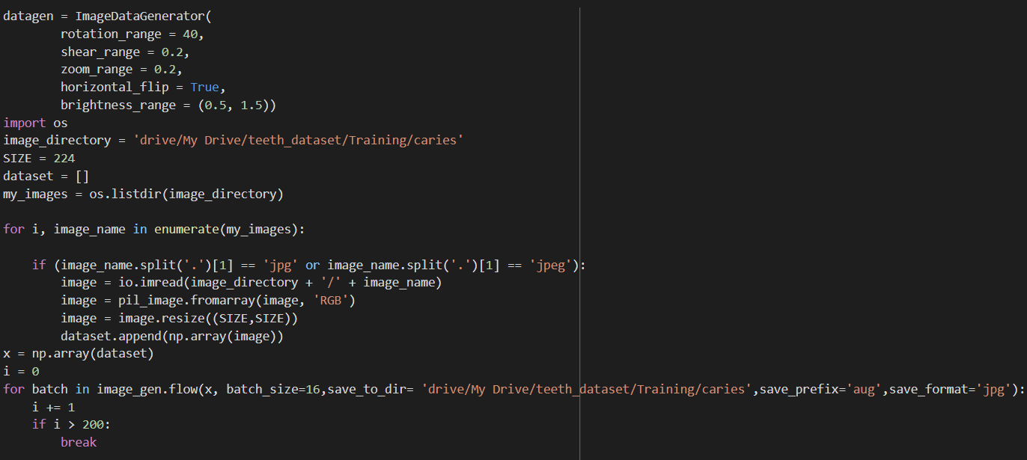

Slide 11


Slide 12
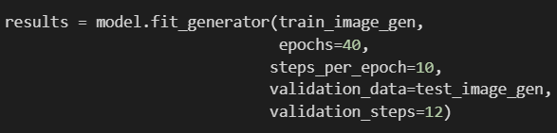

Slide 13
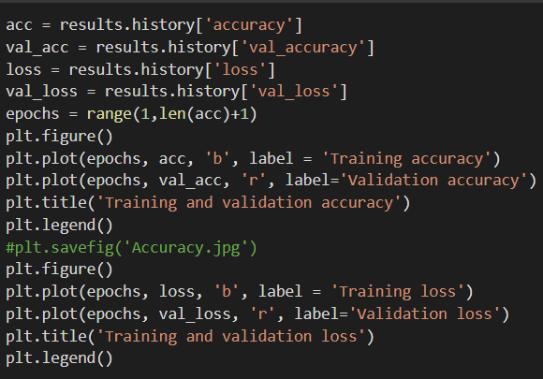

Slide 14
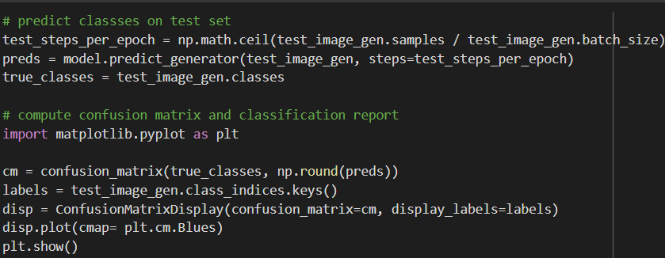

Slide 15
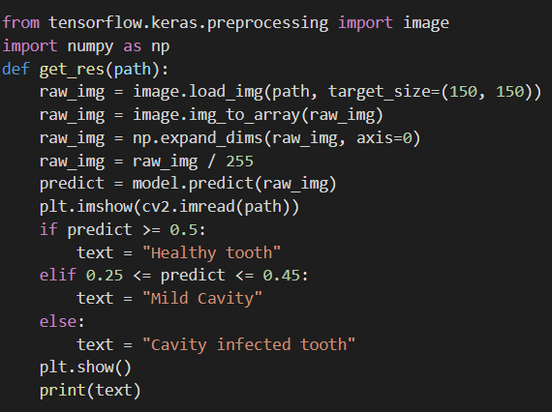

Slide 16
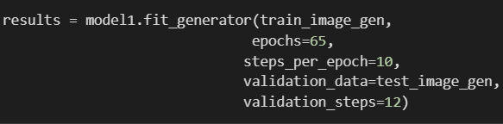

Slide 17
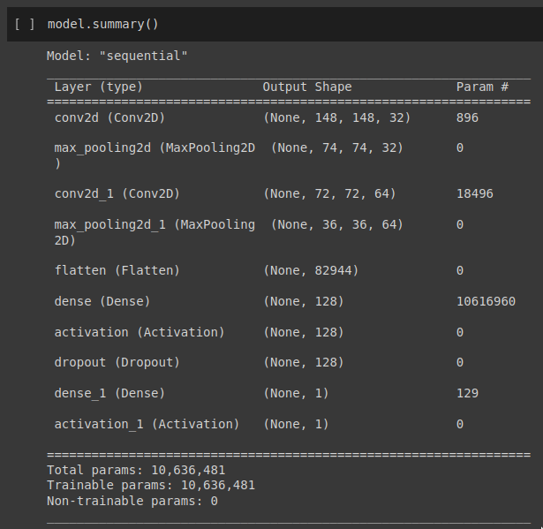

Slide 18
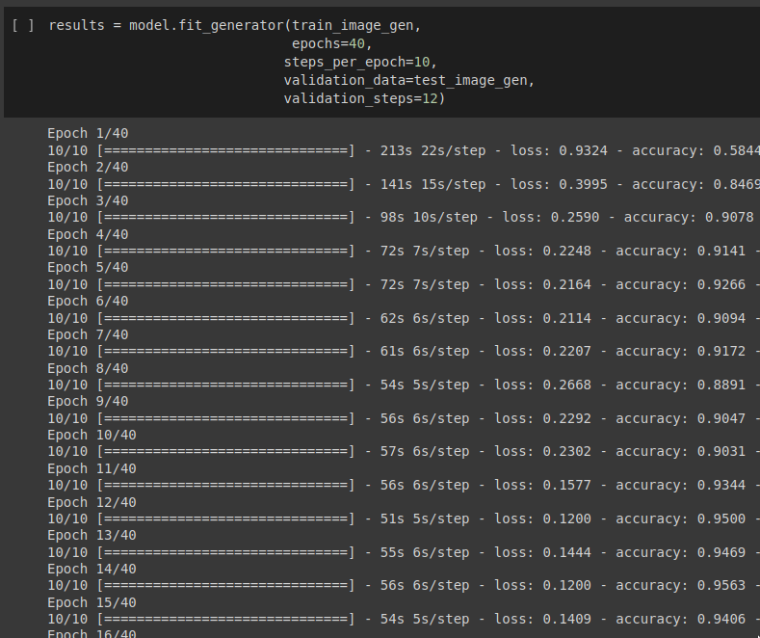

Slide 19
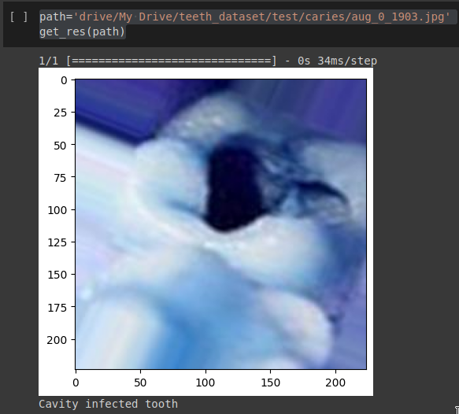

Slide 20
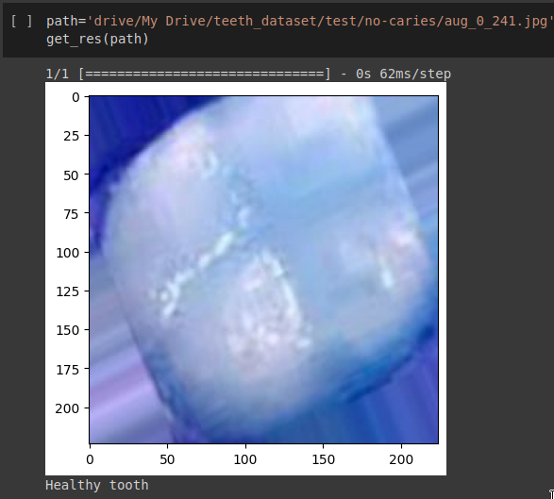

Slide 21
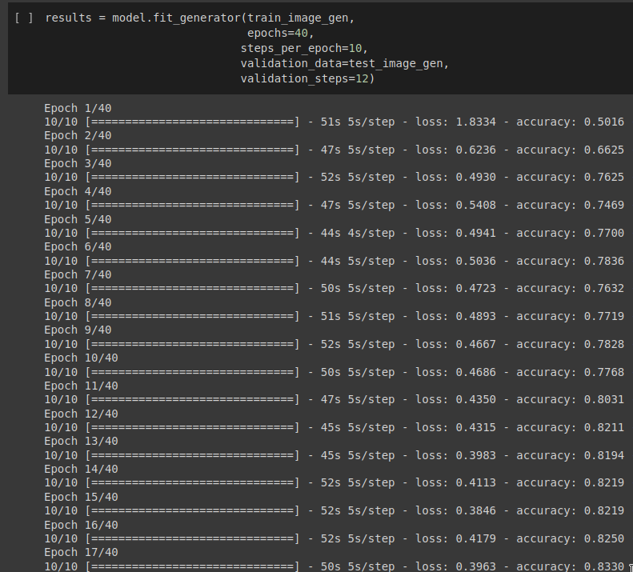

Slide 22
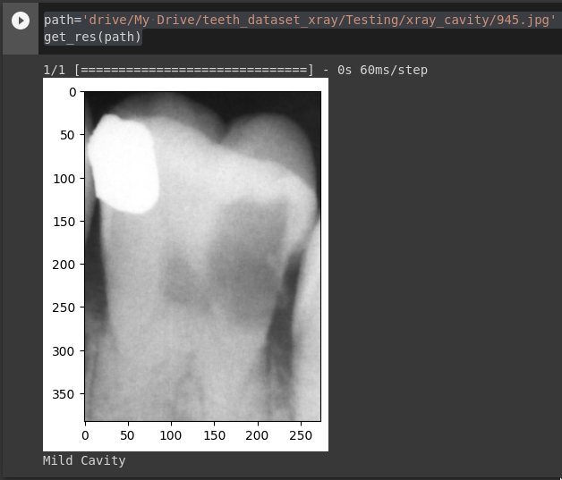

Slide 23
Conclusion
In conclusion, the project aimed to develop a deep learning model for dental cavity detection using convolutional neural networks (CNNs). The project was planned to be different from existing work with the addition of both color and x-ray(greyscale) images to the prediction model compared to the mostly existing works done on just prediction from x-rays. The model was trained on both color images and X-rays to ensure the applicability of the approach in different dental imaging modalities. The proposed model achieved an average accuracy of 93% for color images and 83% for X-rays, indicating promising results for the early detection of dental cavities.​
The approach utilized a combination of image augmentation, and I added 10 layers to the Convolutional Neural Network to maximize the learned parameters and achieve fine-tuned results.​

